Slide 1

GLOBAL INSTITUTE OF TECHNOLOGY
Department of
Computer Science & Engineering
Subject Name with code: Data Structure & Algorithms
Unit-3
Presented by: Mr. Sohan Lal Gupta
Assistant Professor, CSE

Slide 2
GLOBAL INSTITUTE OF TECHNOLOGY JAIPUR
Data Structure & Algorithms
CSE/ III Sem
Lecture No. 4
Sohan Gupta

Slide 3
3.4.4 Quick sort
GLOBAL INSTITUTE OF TECHNOLOGY JAIPUR
Data Structure & Algorithms
CSE/ III Sem
Quicksort is an algorithm based on divide and conquer approach
in which the array is split into subarrays and these sub-arrays are recursively called to sort the elements
Quick sort is a highly efficient sorting algorithm
In quick sort, the partition of the list is performed based on the element called pivot.Here pivot element is one of the elements in the list.
The list is divided into two partitions such that "all elements to the left of pivot are smaller than the pivot and all elements to the right of pivot are greater than or equal to the pivot".
Sohan Gupta

Slide 4
GLOBAL INSTITUTE OF TECHNOLOGY JAIPUR
Data Structure & Algorithms
CSE/ III Sem
For example: In the array {52, 37, 63, 14, 17, 8, 6, 25},
we take 25 as pivot. So after the first pass, the list will be changed like this.
{6 8 17 14 25 63 37 52}
Hence after the first pass, pivot will be set at its position, with all the elements smaller to it on its left and all the elements larger than to its right.
Now 6 8 17 14 and 63 37 52 are considered as two separate sunarrays, and same recursive logic will be applied on them,
and we will keep doing this until the complete array is sorted.
Sohan Gupta

Slide 5
GLOBAL INSTITUTE OF TECHNOLOGY JAIPUR
Data Structure & Algorithms
CSE/ III Sem
Time Complexities
Worst Case Complexity [Big-O]: O(n2)
Best Case Complexity [Big-omega]: O(n*log n) It occurs when the pivot element is always the middle element or near to the middle element.
Average Case Complexity [Big-theta]: O(n*log n) It occurs when the above conditions do not occur.
Space Complexity
The space complexity for quicksort is O(log n).
Sohan Gupta

Slide 6
GLOBAL INSTITUTE OF TECHNOLOGY JAIPUR
Data Structure & Algorithms
CSE/ III Sem
Quick sort algorithm
Step 1 - Consider the first element of the list as pivot (i.e., Element at first position in the list).
Step 2 - Define two variables i and j. Set i and j to first and last elements of the list respectively.
Step 3 - Increment i until list[i] > pivot then stop.
Step 4 - Decrement j until list[j] < pivot then stop.
Step 5 - If i < j then exchange list[i] and list[j].
Step 6 - Repeat steps 3,4 & 5 until i > j.
Step 7 - Exchange the pivot element with list[j] element.
Sohan Gupta

Slide 7
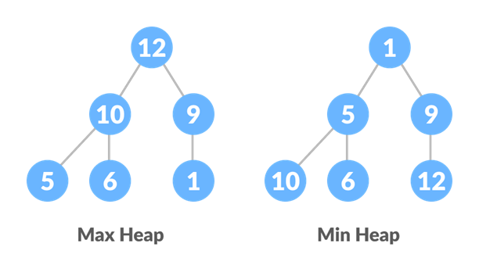
GLOBAL INSTITUTE OF TECHNOLOGY JAIPUR
Data Structure & Algorithms
CSE/ III Sem
3.4.5 Heap sort
Heap sort is a comparison based sorting technique based on Binary Heap data structure
It is similar to selection sort where we first find the maximum element and place the maximum element at the end.
we use Max Heap to arrange list of elements in Descending order and
Min Heap to arrange list elements in Ascending order.
Sohan Gupta

Slide 8
GLOBAL INSTITUTE OF TECHNOLOGY JAIPUR
Data Structure & Algorithms
CSE/ III Sem
Complexity Analysis of Heap Sort
Worst Case Time Complexity: O(n*log n)
Best Case Time Complexity: O(n*log n)
Average Time Complexity: O(n*log n)
Space Complexity : O(1)
Heap sort is not a Stable sort, and requires a constant space for sorting a list.
Heap Sort is very fast and is widely used for sorting.
Sohan Gupta

Slide 9
GLOBAL INSTITUTE OF TECHNOLOGY JAIPUR
Data Structure & Algorithms
CSE/ III Sem
Heap Sort Algorithm
1. Build a max heap from the input data.
2. At this point, the largest item is stored at the root of the heap. Replace it with the last item of the heap followed by reducing the size of heap by 1. Finally, heapify the root of the tree.
3. Repeat step 2 while size of heap is greater than 1.
Sohan Gupta

Slide 10
GLOBAL INSTITUTE OF TECHNOLOGY JAIPUR
Data Structure & Algorithms
CSE/ III Sem
Thank You… .
Any Quries ?
Sohan Gupta

